Slide 1
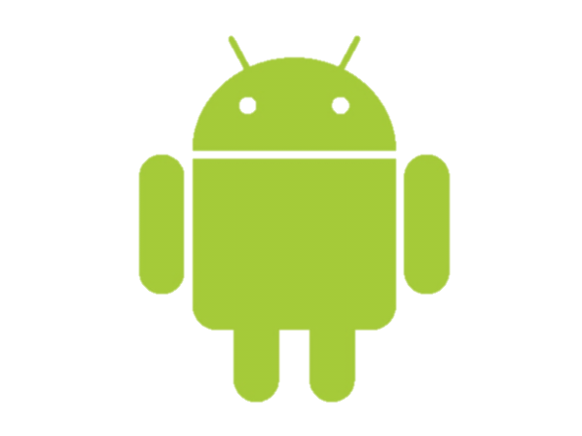
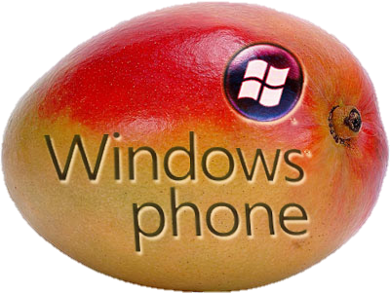



Apache Cordova Overview
The way of hybrid mobile development
Hybrid Mobile Applications
Telerik Software Academy
http://academy.telerik.com

Slide 2


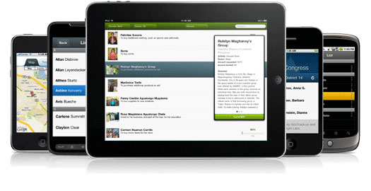
What is Apache Cordova?
Multiplatform Development Framework

Slide 3
What is PhoneGap
Apache Cordova is an open-source mobile development framework
Created by Nitobi Software
Acquired by Adobe Systems
Enables building of hybrid mobile applications using JavaScript, HTML and CSS
Ruby can be used as well
Instead of often less-known languages such as Objective-C and Java

Slide 4
PhoneGap Applications
The Cordova applications are hybrid
All layout rendering is done via the web view instead of Objective-C or Java
Most of the HTML5 features are supported
Yet, as any hybrid app, Cordova apps do not have full access to the device API
Camera, compass, accelerometer, etc.

Slide 5
Supported Platforms
Apache Cordova currently supports development for the following operating systems
iOS, Android, webOS, Windows Mobile, Symbian OS, BlackBerry, Windows Phone 7/8

Slide 6
How does it work?
Build your app once with web-standards
Based on HTML5
Wrap it up with Apache Cordova
Using the free open source framework or PhoneGap build cloud
You can access the native APIs
Deploy to multiple platforms
Standards-based web technologies to bridge web applications and mobile devices

Slide 7




Means of Development

Slide 8
Means of PhoneGap Development
Apache Cordova is just a library that you must include in your app
Couple of JavaScript and xml files
Some native packages for each platform
What is Cordova doing?
Generates a out-of-the-browser window that executes the HTML and JavaScript locally
Due to a couple of xml and jar/dll files it enables the usage of native APIs

Slide 9
Where Can we Develop?
Native IDE for the corresponding OS
Eclipse, Xcode, Visual Studio, etc.
Abode launched a new version of Dreamweaver that integrates with PhoneGap
Build the web site
Add the mobile SDKs
Say it is mobile app
Build and deploy
In both the concrete OS SDK must be present

Slide 10

Pros and Cons
Of PhoneGap Development

Slide 11
Pros of PhoneGap Development
HTML5, CSS and JavaScript skills vs. Objective-C, Java and C#
Single, reusable code base for all platforms
iOS, Android, WP 7, WP 8, mobile web
You can take advantage of distribution and integrated payment
Via the App Store, Google Play, etc…

Slide 12
Cons of PhoneGap Development
Poor performance
If your app is graphically intense, i.e. a game.
Caching or leveraging some 3rd party solutions may be implemented with native graphics
For the most part a native app is much faster/smoother than hybrid mobile app

Slide 13
Cons of PhoneGap Development (2)
Lack of pre-built UI widgets, transitions, standard controls, etc.
Your development time can take longer
Especially if you want a polished-looking app with a native look and feel
Yet many third-party component libraries exist
Kendo UI Mobile, jQuery Mobile, Sencha Touch

Slide 14
PhoneGap

